Slide 1

Advanced simulation of analog/digital circuits modeled as hybrid systems: the PAN simulation environment
Federico Bizzarri
Dipartimento di Elettronica, Informazione e Bioingegneria, Politecnico di Milano
P.za Leonardo da Vinci 32, I-20133 Milano, Italy
e-mail: federico.bizzarri@polimi.it

Slide 2
I would like to show you that HST ∩ CS≠∅
HST ∩ CS
has a great impact in modern electronic circuit design which means a great impact in the day life of all of us.
Hybrid Systems Theory
(HST)
Provide circuit designers with reliable and effective simulation tools improves the quality and reduce the cost of a lot of equipments that are pervasive in our society …
Circuit Simulation
(CS)
… anyone using a mobile phone (and hoping in a cheaper one) should be interested in this talk!

Slide 3
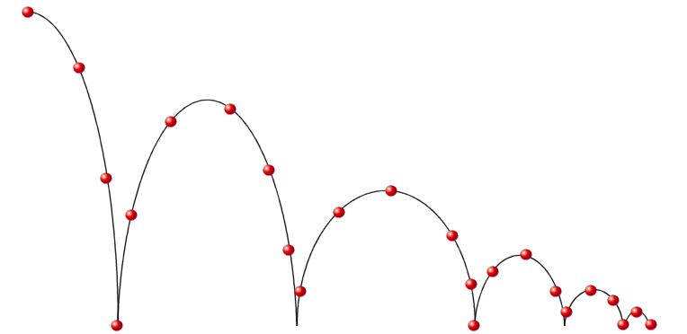
Hybrid system: from the Wikipedia
“A hybrid system is a dynamic system that exhibits both continuous and discrete dynamic behavior – a system that can both flow (described by a differential equation) and jump (described by a difference equation or control graph). Often, the term "hybrid dynamic system" is used …
A canonical example of a hybrid system is the bouncing ball, a physical system with impact. Here, the ball (thought of as a point-mass) is dropped from an initial height and bounces off the ground, dissipating its energy with each bounce. The ball exhibits continuous dynamics between each bounce; however, as the ball impacts the ground, its velocity undergoes a discrete change modeled after an inelastic collision.

Slide 4
Circuit Simulation: from the Wikipedia
“Electronic circuit simulation uses mathematical models to replicate the behavior of an actual electronic device or circuit. Simulation software allows for modeling of circuit operation and is an invaluable analysis tool.”
“Due to its highly accurate modeling capability, many Colleges and Universities use this type of software for the teaching of electronics technician and electronics engineering programs. Electronics simulation software engages the user by integrating them into the learning experience. These kinds of interactions actively engage learners to analyze, synthesize, organize, and evaluate content and result in learners constructing their own knowledge.”
“Simulating a circuit’s behavior before actually building it can greatly improve design efficiency by making faulty designs known as such, and providing insight into the behavior of electronics circuit designs. In particular, for integrated circuits, the tooling (photomasks) is expensive, breadboards are impractical, and probing the behavior of internal signals is extremely difficult. Therefore almost all IC design relies heavily on simulation.”

Slide 5
A little bit of background(.zip)
Circuit simulation was born in the early seventies’ in the Academia (University of Berkley).
Historically both the Academia and software companies worked hard to develop circuit simulation and both are still working (hard) to improve it even if it seems to be no longer an interesting task … why?
eldo, spectre and hspice are the most employed simulators in industrial environments. People working in industries typically have no time to learn something new if what they daily uses works pretty well (… and sometime even if it doesn’t) and this seems to leave no room for other competitors.
Nevertheless there are some attempts in the Academia not to simply implement faster versions of existing algorithms but to propose new techniques to overcome well known limitations of the available simulators.

Slide 6
I will try …
… to show you one of the main limitation that can be overcome by resorting to hybrid systems theory (and formalism).
It concerns the analysis and simulation of analog/digital circuits, more specifically autonomous and non-autonomous analog/digital circuits exhibiting a periodic steady state behaviour.
These circuits are extremely important … one of them is the famous Phase Lock Loop (PLL) and you can find it in several applications (and of course in your mobile phone!)

Slide 7
The flow of ideas
Why HST ∩ CS ≠∅?

Slide 8

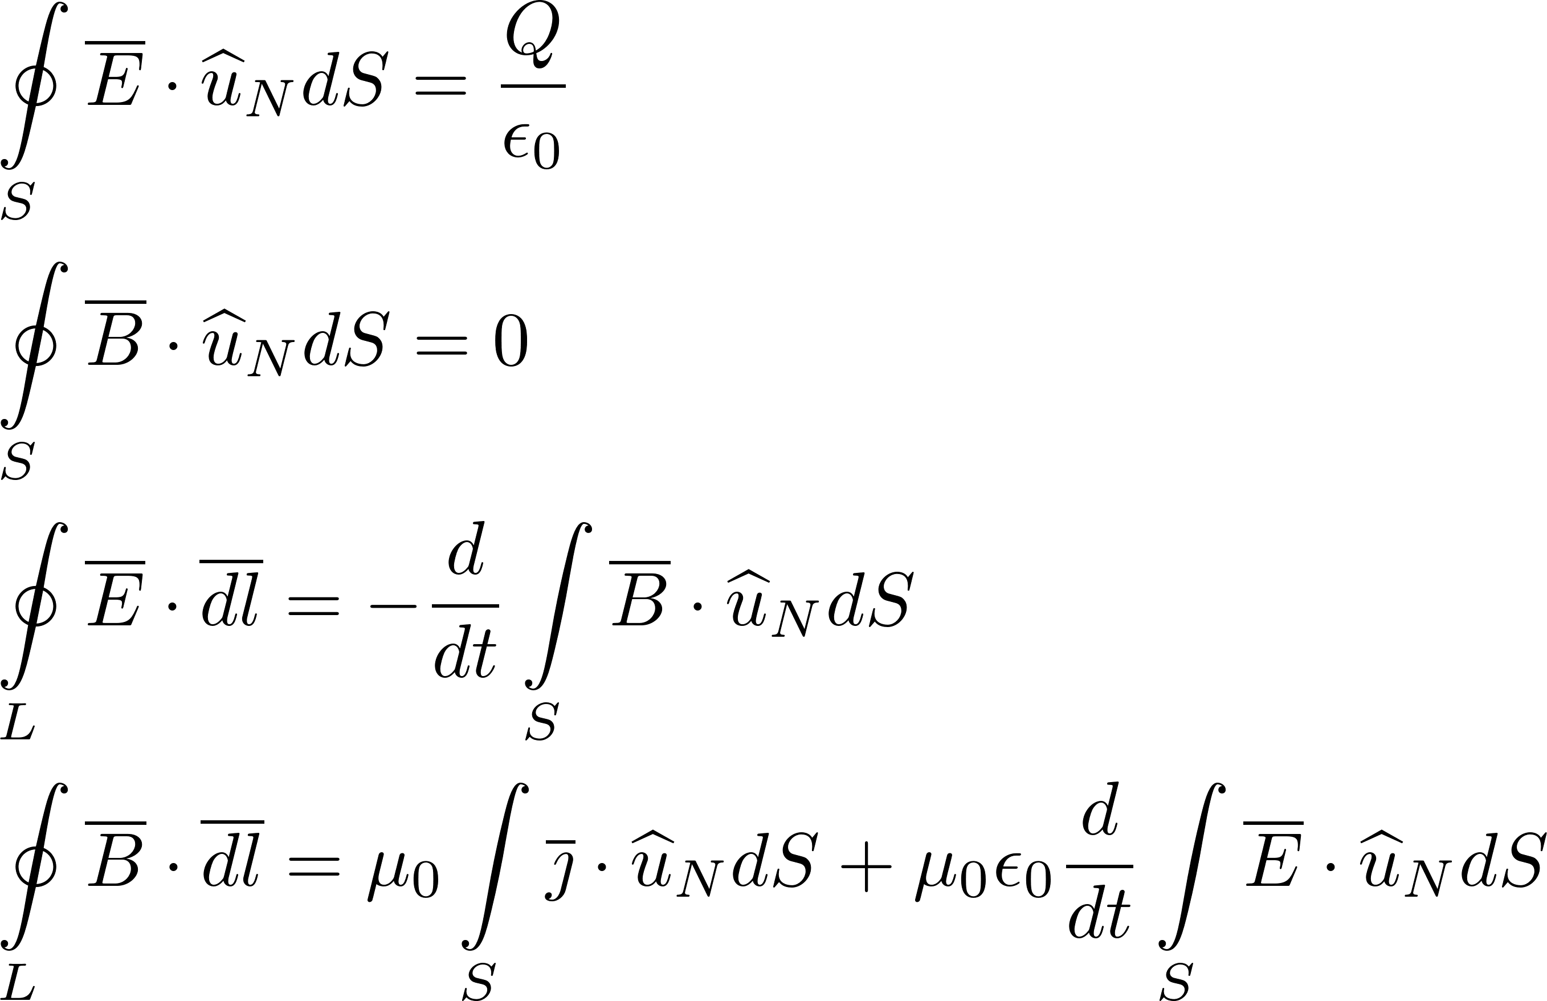
Electronic circuit simulation uses mathematical models to replicate the behavior of an actual electronic device or circuit.
Circuit designers
(and my students too) typically do not “love” them!
“Maxwell’s Equations provide a complete description of electromagnetic phenomena and underpin all modern information and communication technologies”. (http://www.ieeeghn.org/wiki/index.php/STARS:Maxwell's_Equations)

Slide 9
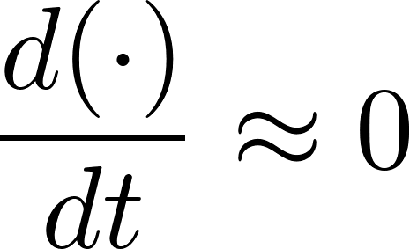
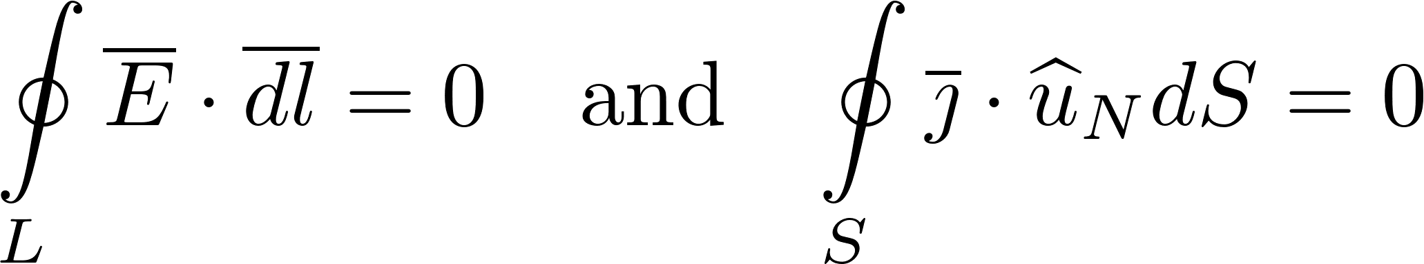
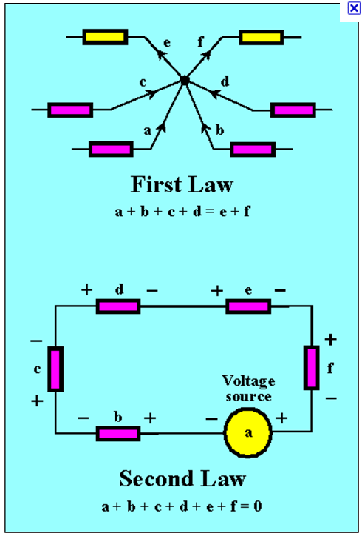
Under the hypothesis of quasi-stationarity one can derive from Maxwell’s laws (3rd and 4th) the voltage and current Kirchhoff laws which are the basis of lumped-circuit theory.
Maxwell’s laws
(3rd and 4th)
Kirchhoff Voltage Law
(a potential exists for the electric field)
a+f+e+d+c+b=0
Kirchhoff Current Law
(charge conservation principle)
a+b+c+d=e+f

Slide 10
Quasi-stationarity makes circuit designers very happy because
all phenomena related with electro-magnetic propagation can be neglected. ⁽¹⁾
the relative position of circuit components is no longer important and one can focus on topology only, i.e. on the interconnections between components without taking care of their positioning in space.⁽²⁾
This means that signal propagation-time from one element to the other is negligible. 'Negligible' means that the time it takes for the signal produced at one point on the circuit to propagate to the rest of the circuit is (very) small compared to the times involved in circuit operation. We are obviously not focusing on those circuits (or better on those sub circuits of a larger circuit) that are conceived to deal with electro-magnetic propagation (e.g. an FM receiver).
(2) We neglect all those problems that a designer must face when trying to integrate millions of devices in few cm²: it is hard but the difficulty does not basically depend on electromagnetic propagation.

Slide 11
The flow of ideas
Why HST ∩ CS ≠∅?
  We do not want to use Maxwell’s laws we rather prefer Kirchhoff laws.

Slide 12



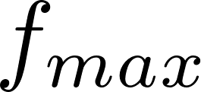


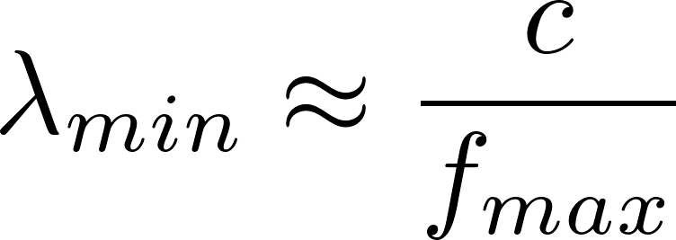

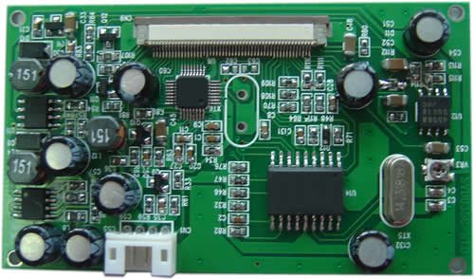
We must spend some words on the quasi-stationarity assumptions. What does it mean in practice?
The wavelength of the highest frequency component of all the waveforms (voltages and currents) involved in given circuit must be much larger than the circuit dimension.

Slide 13
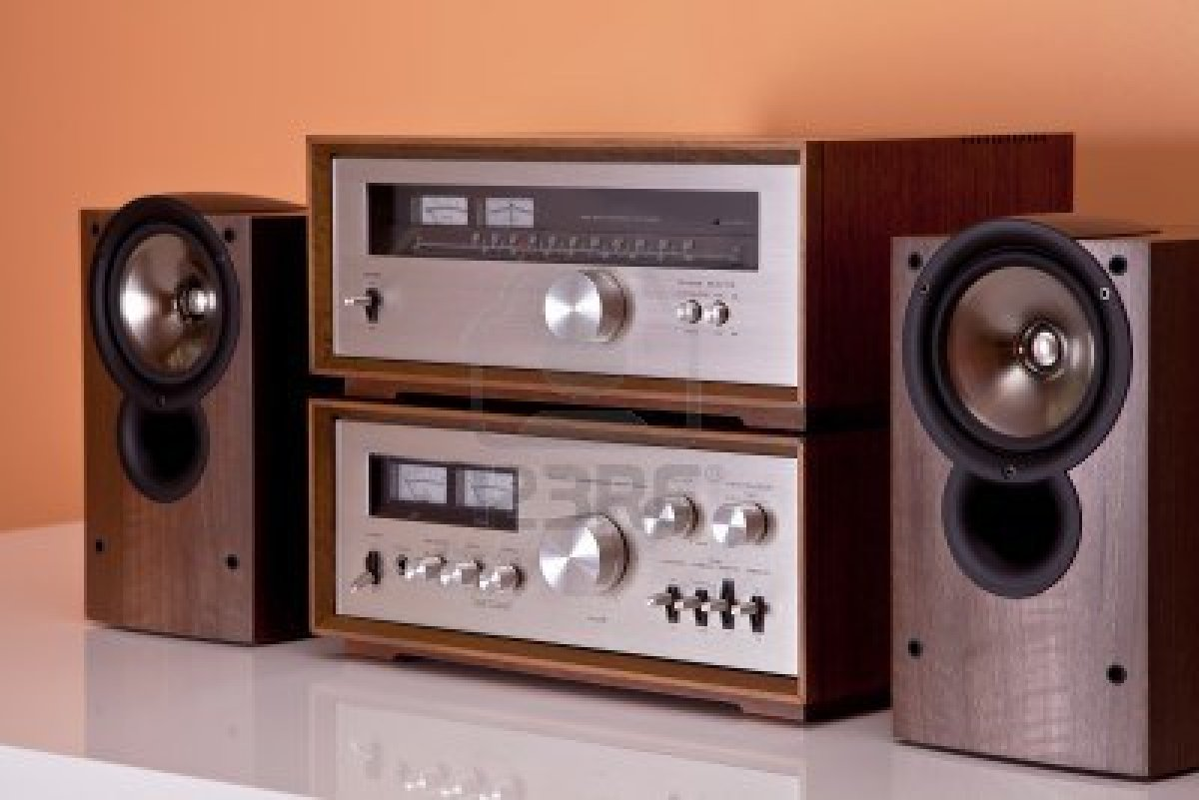
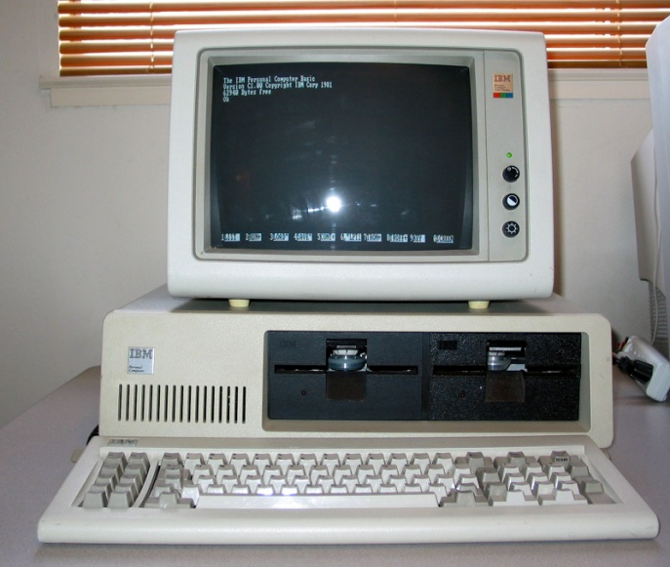

A vintage stereo
Highest frequency: from 25Khz
(no radio receiver) to 100Mhz
Smallest wavelength:
light speed/25Khz ≈ 12km
light speed/100Mhz ≈ 3m
A vintage PC
Highest frequency: 25Mhz
Smallest wavelength:
light speed/25Mhz ≈ 12m
A modern laptop
Highest frequency: 4GHz
microprocessor speed
package 0.0375m x 0.0375m
Smallest wavelength:
light speed/4GHz ≈ 0.075m
(with care)

Slide 14
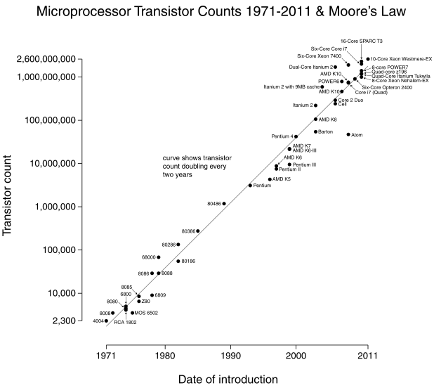
If we want to go faster being sure to work with lumped circuits, we must reduce the dimension of the circuit but history says that “we cannot reduce” the number of devices (transistors) …
Moore's law
is the observation that, over the history of computing hardware, the number of transistors on integrated circuits doubles approximately every two years.

Slide 15
Intel estimates that about 10 quintillion (or a 1 followed by 19 zeros) transistors ship each year. That is 10,000 times the number of ants on Earth!

Slide 16
… then we must reduce the dimension of the single device!
On Dec. 16, 1947 the transistor was invented at Bell Labs:
the first transistor was about the size of the palm of a hand,
with a depth of two matchboxes stacked on top of each other.
Semiconductor manufacturing processes
10 µm — 1971
3 µm — 1975
1.5 µm — 1982
1 µm — 1985
800 nm — 1989
600 nm — 1994
350 nm — 1995
250 nm — 1997
180 nm — 1999
130 nm — 2002
90 nm — 2004
65 nm — 2006
45 nm — 2008
32 nm — 2010
22 nm — 2012
14 nm — est. 2014
10 nm — est. 2015
7 nm — est. 2020
5 nm — est. 2022
Let me say I see a limit … could we put a transistor in a single atom?
This is the basis of quantum computation but it is another story!

Slide 17
The flow of ideas
Why HST ∩ CS ≠∅?
  We do not want to use Maxwell’s laws we rather prefer Kirchhoff laws.
  To use Kirchhoff laws the quasi-stationarity condition must be satisfied (mind the circuit dimension vs. minimum wavelength!).

Slide 18
“Which mathematical model one should use to describe a lumped circuit”?
The correct answer would be “Differential Algebraic Equations” (DAEs) but we can limit our discussion to “Ordinary Differential Equations” (ODEs).
Who are the state variables?
“In a lumped circuit the states variables are voltage across capacitors and current through inductors”.
How many state variables?
“It depends on how many capacitors and inductors we really want in a given circuit but …
… it depends also on parasitic components that are always present in the real model of nonlinear components such as MOS transistor”.

Slide 19
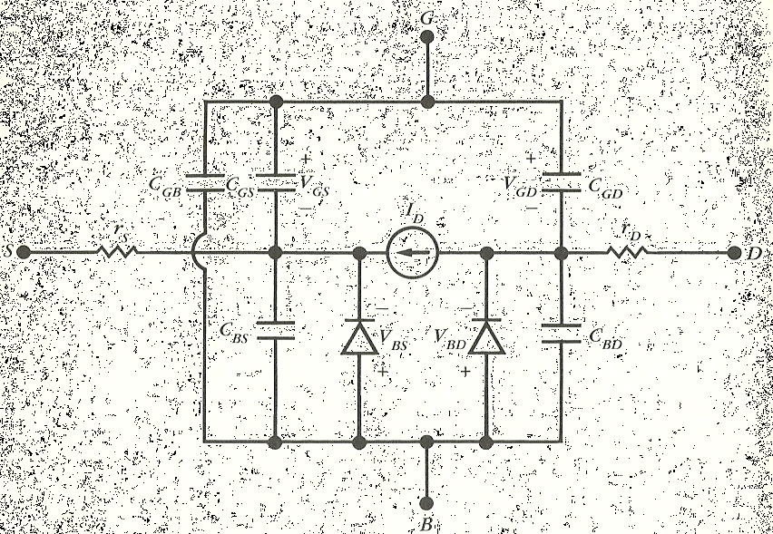
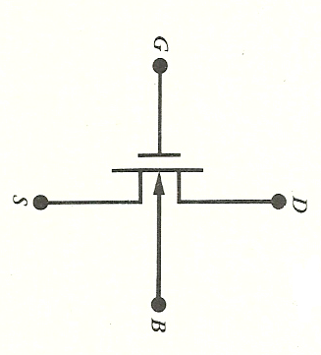
5 parasitic capacitors
n-channel MOST
n-channel MOST: large signal model
(PSPICE level 2 model - 1980)
This is a basic and extremely simplified model … parasitic capacitances are much more than 5 … they are tens in a modern simulation model.

Slide 20
How many transistor in your smartphone?
Almost 50.000.000 … It means much more than 250.000.000 state variables!
A circuit designer says: “I am sorry but … I am not able to simulate your smartphone … with a fourth order variable step-size Runge-Kutta method (or with a more reliable method!) even if you provide me with the analytical expression of the vector field!”
A customer says: “But I really want a new smartphone … can you build prototypes?”
A circuit designer says: “I am sorry once more … if I built more than extremely few prototypes you would pay your new smartphone more than my CEO private jet … ”
A customer says: “I do not understand … why my present smartphone was cheaper?”

Slide 21
The flow of ideas
Why HST ∩ CS ≠∅?
  We do not want to use Maxwell’s laws we rather prefer Kirchhoff laws.
  To use Kirchhoff laws the quasi-stationarity condition must be satisfied (mind the circuit dimension vs. minimum wavelength!).
  We must solve a lot of ODEs (DAEs) … so many that it is practically impossible to solve them.

Slide 22
There is a missing ingredient …
… in an analog world^{(*)} circuit designer love digital modeling!
A given analog circuit is divided in several functional blocks that are represented in the digital world and their analog description can be forgotten.
(*) It could be certainly interesting to discuss on the very nature of the real world: is it analog or is it digital? Perhaps we should say neither analog nor digital: they are two different but complementary ways of describing reality. But let me say that “common sense” is for an analog world.

Slide 23
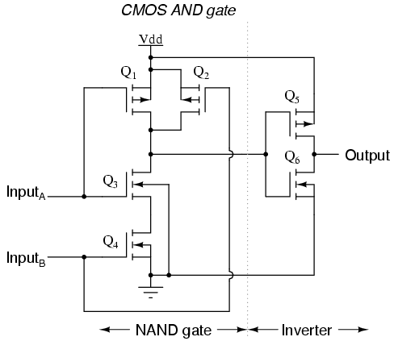
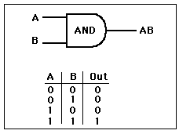
Very basic examples are logical gates implementing Boolean Algebra
Behavioral model
Analog circuit model
(6 transistors)

Slide 24
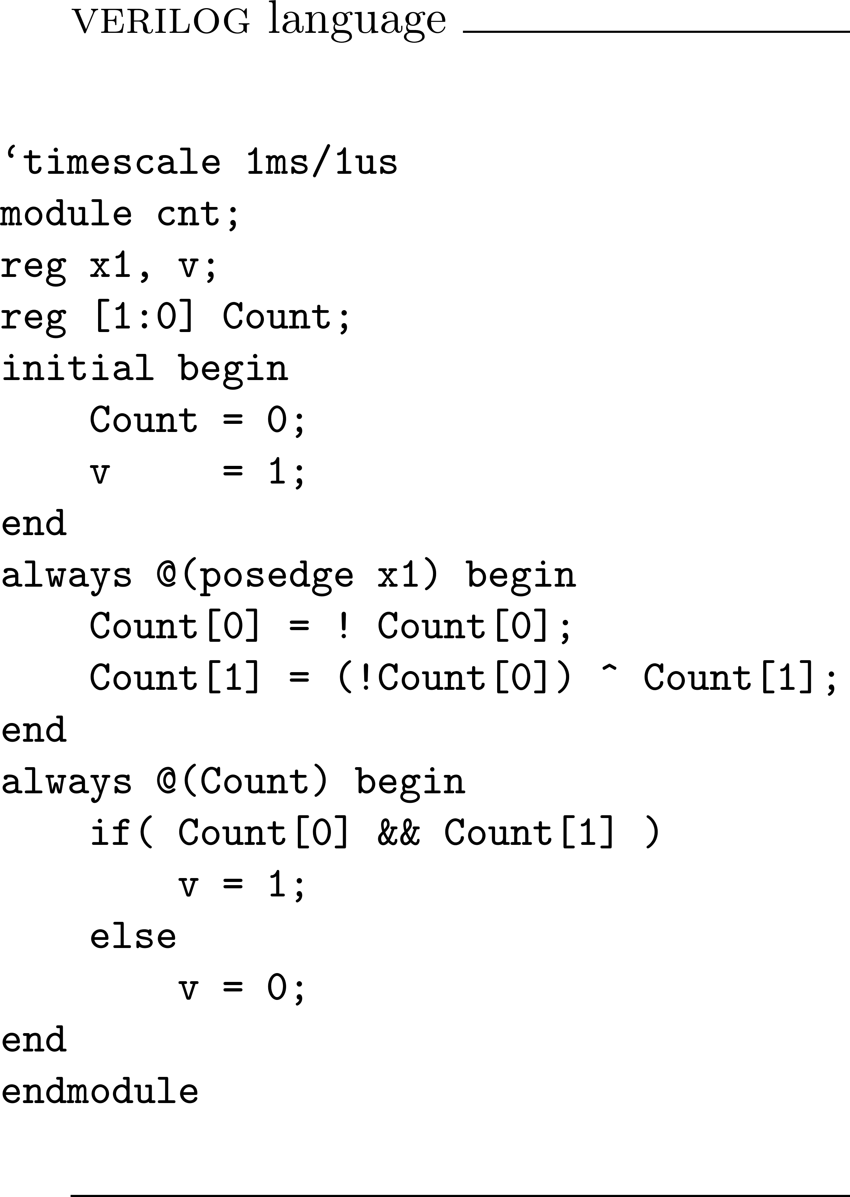

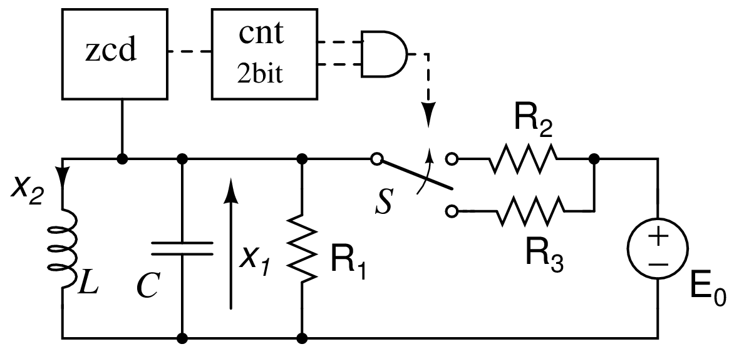





More complex functional blocks are typically described by
behavioral languages.
a two bit counter followed by an AND gate

Slide 25
The flow of ideas
Why HST ∩ CS ≠∅?
  We do not want to use Maxwell’s laws we rather prefer Kirchhoff laws.
  To use Kirchhoff laws the quasi-stationarity condition must be satisfied (mind the circuit dimension vs. minimum wavelength!).
  We must solve a lot of ODEs (DAEs) … so much that it is practically impossible to solve them.
  Digital/behavioral modeling makes it possible to simulate real life circuits

Slide 26
Commercial circuit simulators are equipped with mixed analog/digital simulation capabilities but they do not allow an overall model and so doing important simulations that can be performed on analog circuits are not available for mixed signals ones.
A2D
Analog (sub)circuit
Digital behavioral (sub)circuit
D2A

Slide 27
We want to define “a better” interface between
the analog part of the circuit and the digital/behavioral one.
It is not a software problem … it is a modeling problem.
A2D
Analog (sub)circuit
Digital behavioral (sub)circuit
D2A

Slide 28
The flow of ideas
Why HST ∩ CS ≠∅?
  We do not want to use Maxwell’s laws we rather prefer Kirchhoff laws.
  To use Kirchhoff laws the quasi-stationarity condition must be satisfied (mind the circuit dimension vs. minimum wavelength!).
  We must solve a lot of ODEs (DAEs) … so much that it is practically impossible to solve them.
  Digital/behavioral modeling makes it possible to simulate real life circuits … but a “better” simulation environment is needed with respect to the existing (commercial) ones.

Slide 29


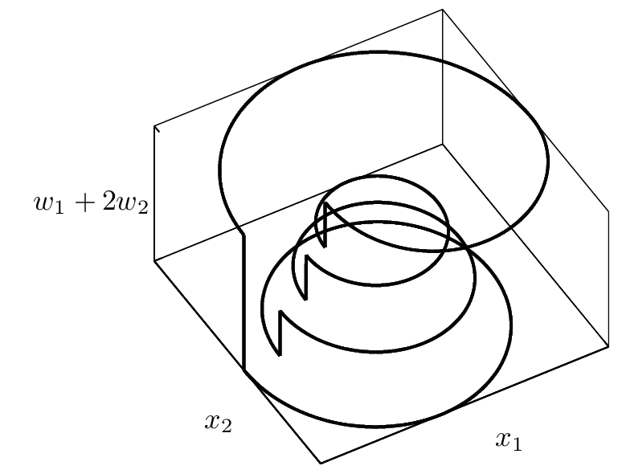
This is a mixed analog/digital circuit …
… it is an analog/digital oscillator!
I would like to know if this limit cycle is stable or not … can I evaluate its Floquet multipliers?
With a commercial simulator it is not possible (at now).

Slide 30

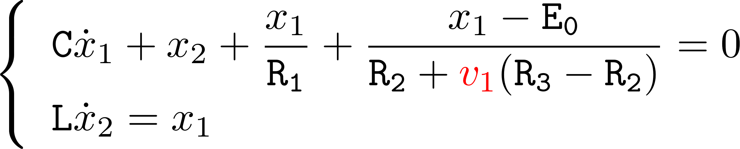

Rewind …
This is a mixed analog/digital circuit.
State equations
The (state) variable models the switch and it can be ‘1’ or ‘0’ … it is digital.
Who decides its digital value?

Slide 31
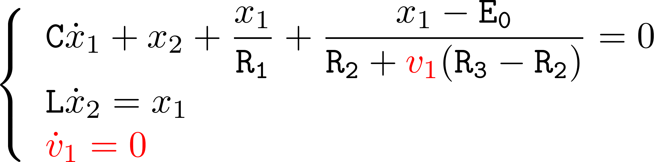
Logical/decisional process
“Hybrid systems are made up of dynamical continuous/discrete time evolution processes interacting with logical/decisional processes”
Peters, K., & Parlitz, U. (2003). Hybrid systems forming strange billiards. International Journal of Bifurcation and Chaos in Applied Sciences and Engineering, 13(9), 2575– 2588.
Continuous time evolution process
The decisional process changes the value (impact) of (digital state) according to a reset function and a switching is observed in the analog vector field.

Slide 32
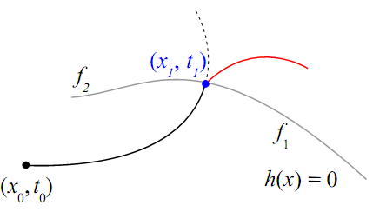
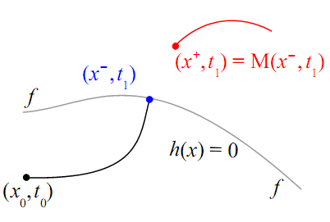
Hybrid systems (state and vector field point of view)
“Hybrid systems are made up of dynamical time continuous/discrete evolution processes interacting with logical/decisional processes”
Switching dynamical systems
Discontinuous vector field but continuous state
Impact dynamical systems
The state of the system exhibits time domain discontinuities

Slide 33


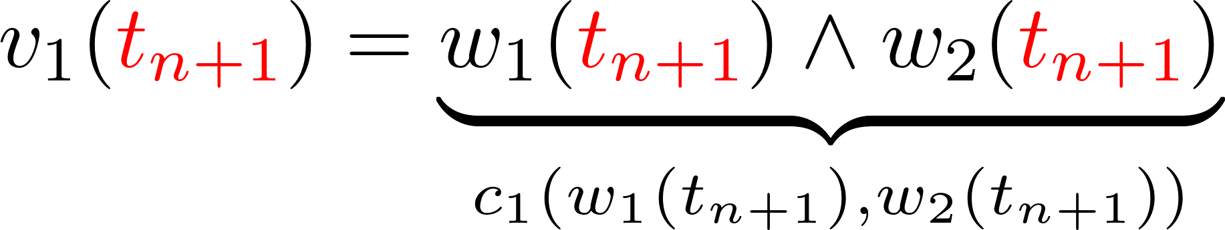
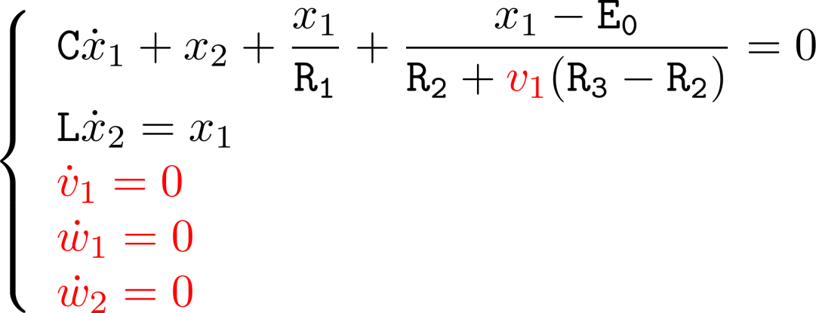
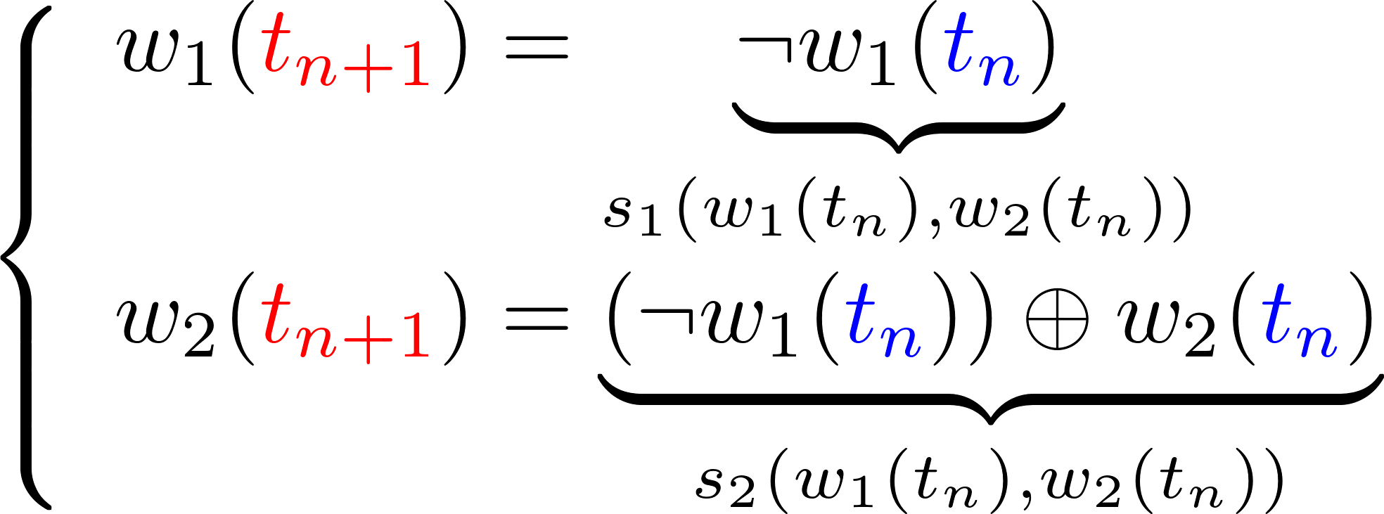
Combinatorial function
The model is not complete since the two bit counter has a digital state …
Sequential function
Who triggers the events of the sequential function? There is a zero-crossing-detector in the circuit … defining a manifold …

Slide 34
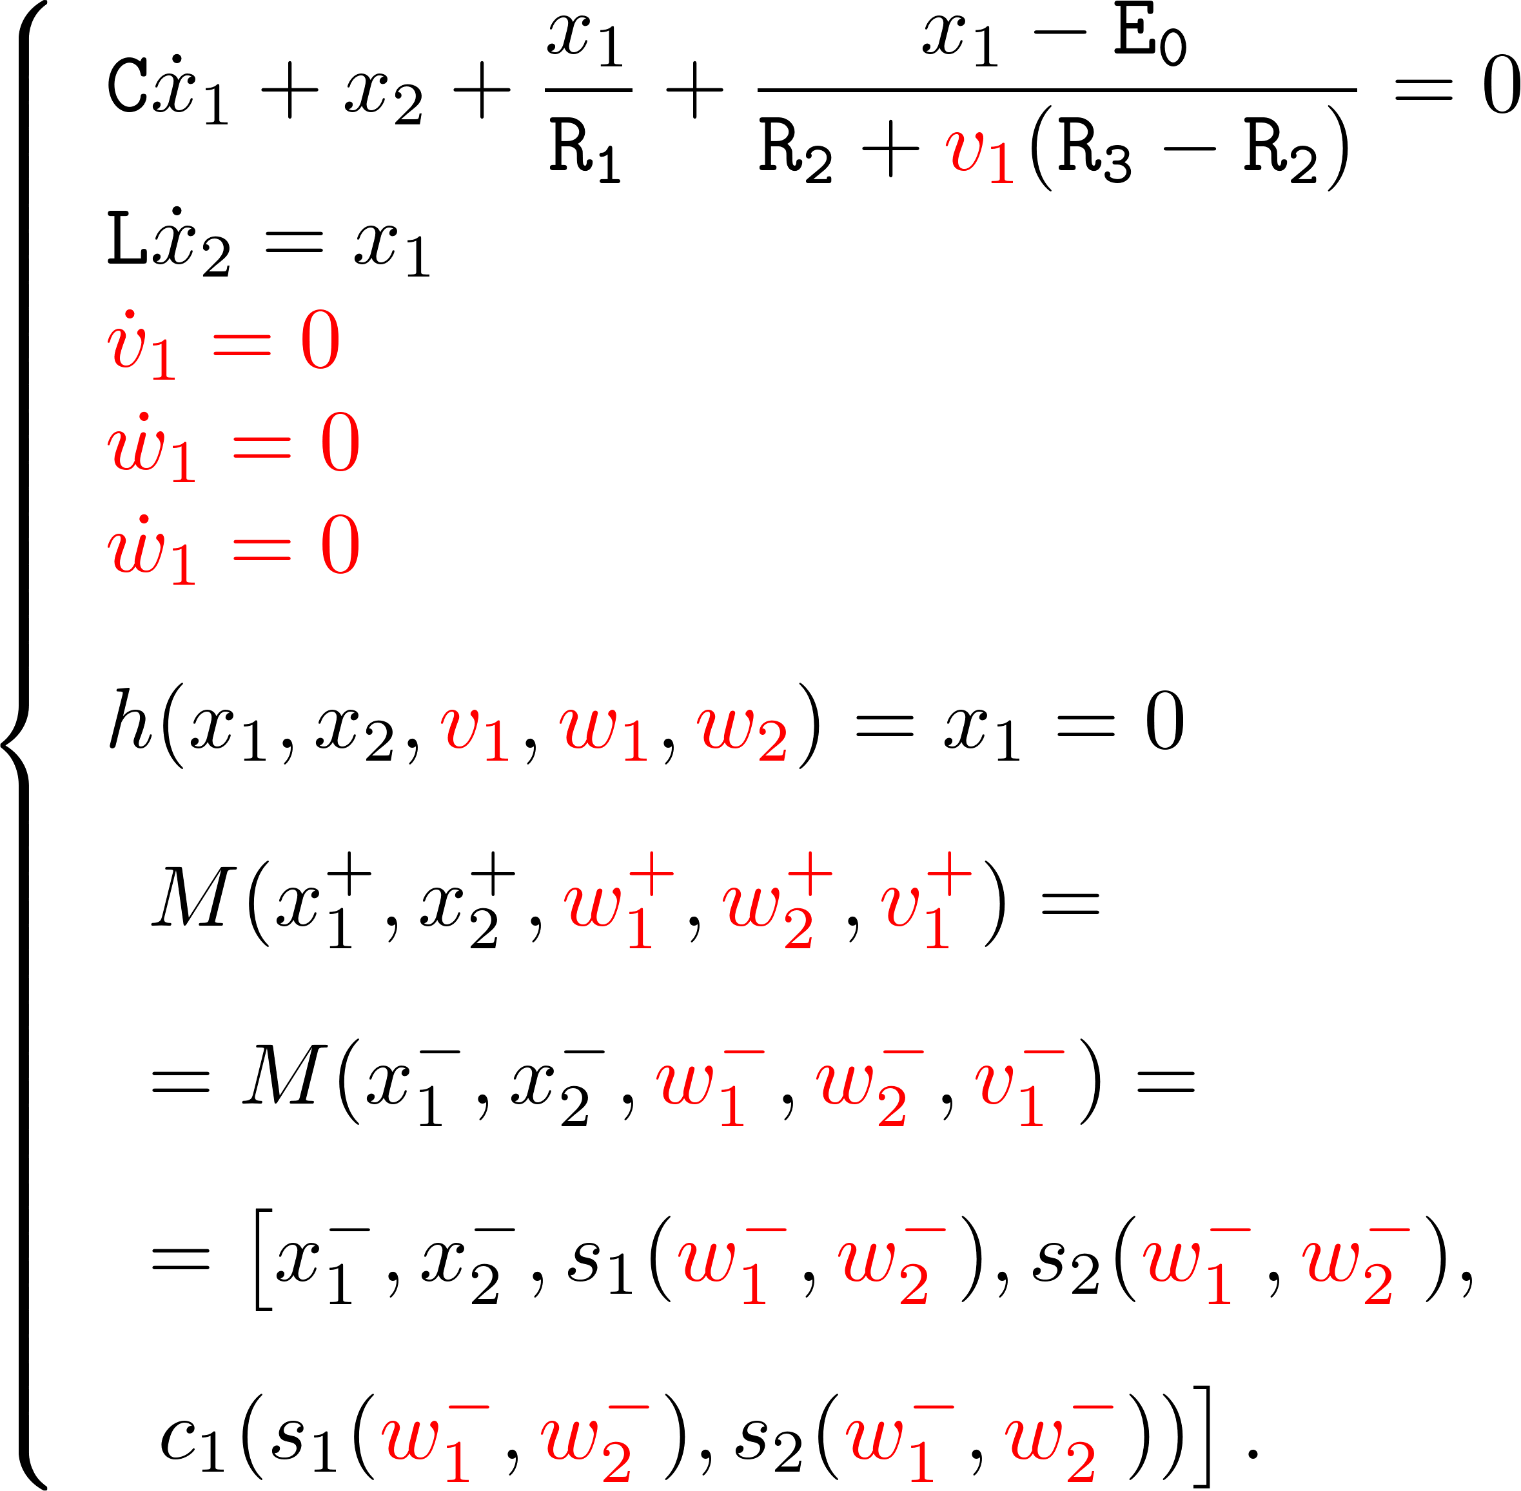
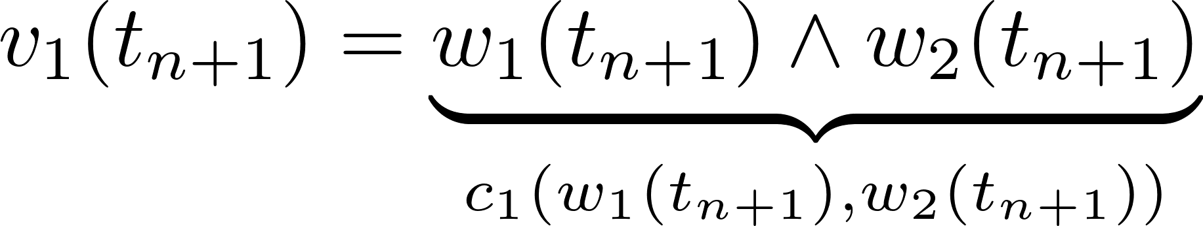
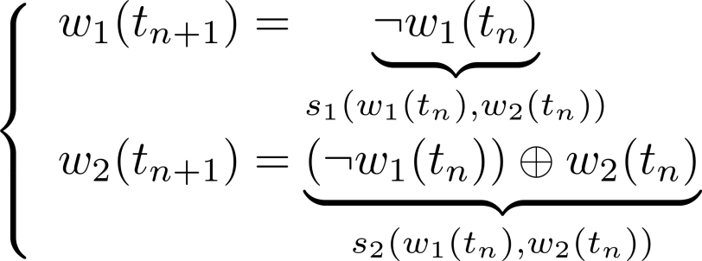
Combinatorial function
Sequential function
Definitively
HST ∩ CS ≠∅

Slide 35
The flow of ideas
Why HST ∩ CS ≠∅?
  We do not want to use Maxwell’s laws we rather prefer Kirchhoff laws
  To use Kirchhoff laws the quasi-stationarity condition must be satisfied (mind the circuit dimension vs. minimum wavelength!)
  We must solve a lot of ODEs (DAEs) … so much that it is practically impossible to solve them
  Digital/behavioral modeling makes it possible to simulate real life circuits … but a “better” simulation environment is needed with respect to the existing (commercial) one.
  The hybrid systems modeling framework is suitable for handling analog/digital (behavioral) circuits

Slide 36
The Floquet multipliers related to the analog ^{(*)} section of the oscillator are
μ₁ = 1.0087 (that corresponds to that theoretically equal to 1) and
μ₂ = 0.41273.
(*) There are three null multipliers related to the digital section of the circuit.
For anyone working with hybrid systems it is easy to be convinced that we succeed in evaluating the Floquet multipliers for this simple oscillator … but …
… it is not so obvious … eldo, spectre and hspice are not able to evaluate those multipliers and they are not able to perform many other analyses when dealing with analog/digital circuits.

Slide 37
Le fil rouge
There is a common element to several numerical analyses (shooting method, periodic small-signal analysis, periodic noise analysis) that we usually perform when a “smooth” circuit exhibiting a periodic steady state solution is simulated: the fundamental matrix.
The fundamental matrix is “not defined” for systems characterized by a discontinuous vector field or state.
        Analog circuits with “switches”
        Analog/digital mixed circuits
        Circuits partially described by a “behavioral” language
        Circuits exhibiting very sharp transitions that cannot be “tracked” by the computer ALU
        …
… more precisely … the fundamental matrix is not defined in correspondence to the vector field discontinuities.
To be able to extend the fundamental matrix definition at these points would allow to retain the aforementioned analyses for these circuits!
①
Steady state computation
Time-varying transfer functions
Noise analysis
Close the loop
②
Hybrid dynamical systems
③
Saltation matrix

Slide 38
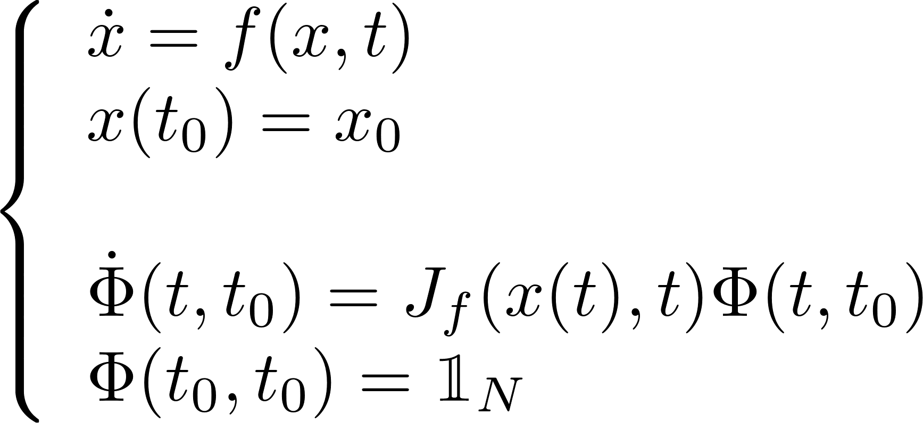
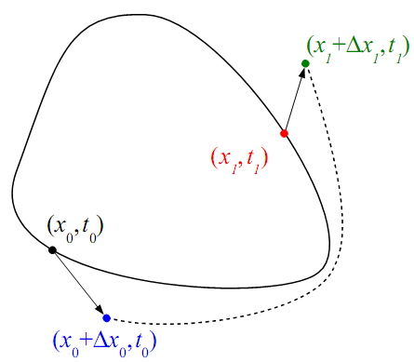
The fundamental matrix
From a practical point of view the fundamental matrix can be obtained by performing a Forward Sensitivity Analysis (FSA) of the system trajectories with respect to the initial conditions or, in other words, solving the variational problem:
If x_{s} (t) is the solution then it is possible to compute (at first order) the effect Δx_{s}(t) on the solution produced by a small perturbation Δx₀ of the initial conditions
Δx_{s}(t) = Φ(t,t₀) Δx₀(t₀)

Slide 39
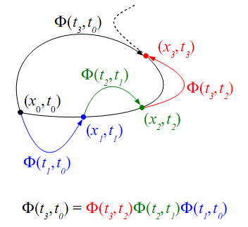
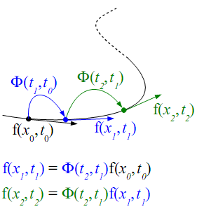
The fundamental matrix: two basic properties
Composition property
Mapping property

Slide 40
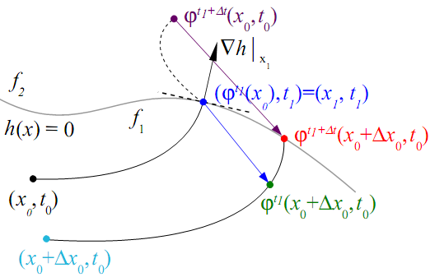
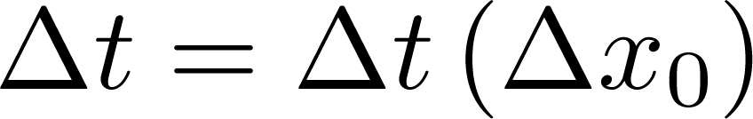
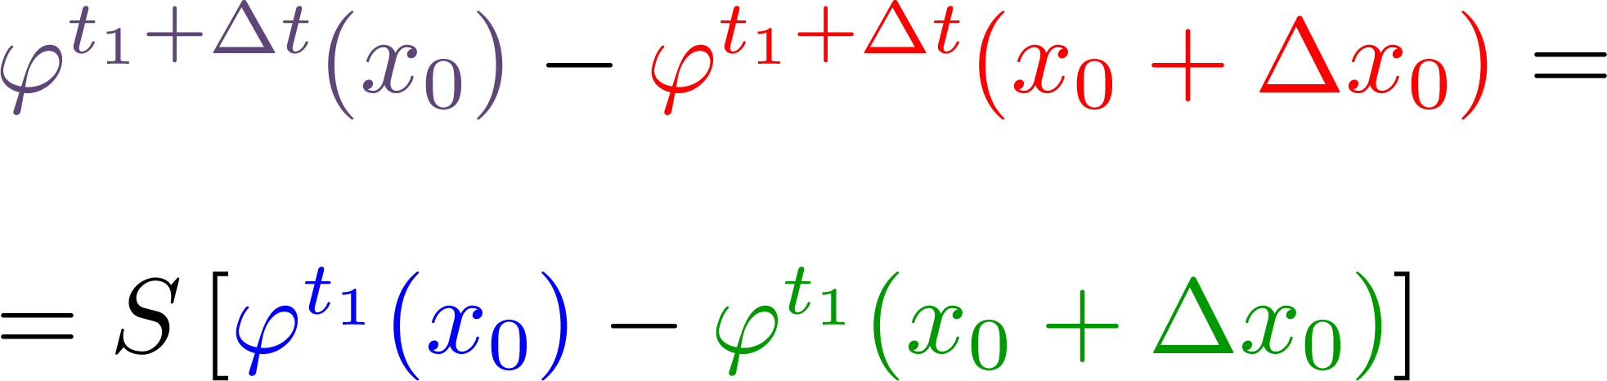
The saltation matrix
Region 2 – Vector field f₂
First goal
at first order
in Δt
Switching
Manifold
Unperturbed IC
in t₁−t₀
Perturbed IC
Region 1 – Vector field f₁
Second goal
at first order

Slide 41
The saltation matrix
Region 2 – Vector field f₂
in Δt
Switching
Manifold
Unperturbed IC
in t₁−t₀
Perturbed IC
Region 1 – Vector field f₁

Slide 42
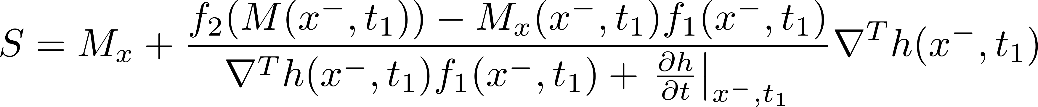
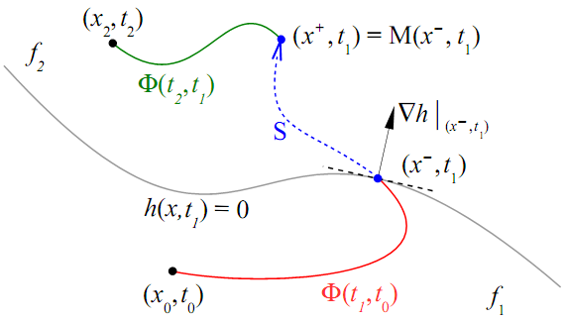
The saltation matrix

Slide 43
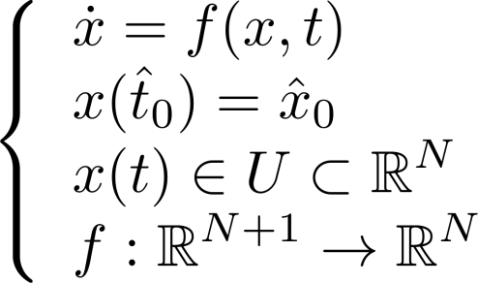
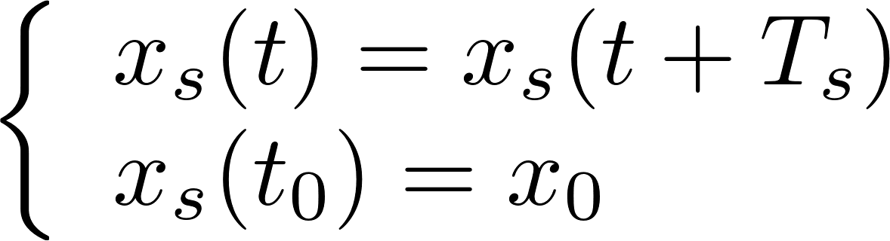
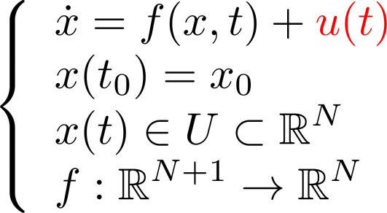
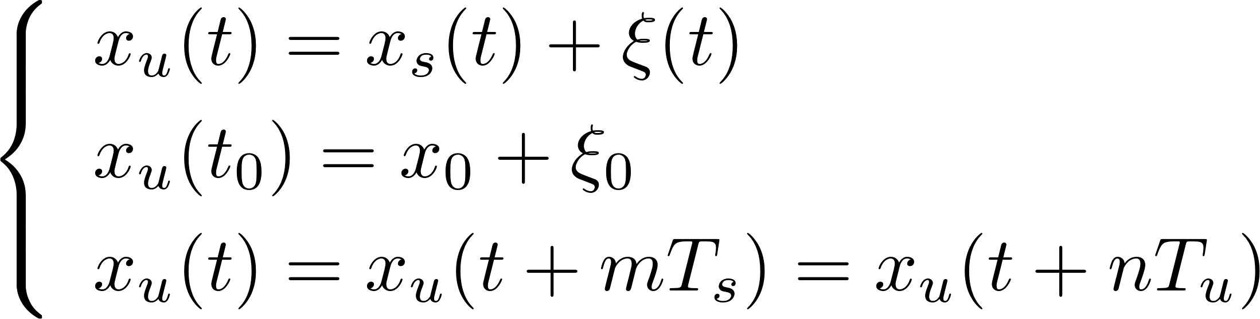
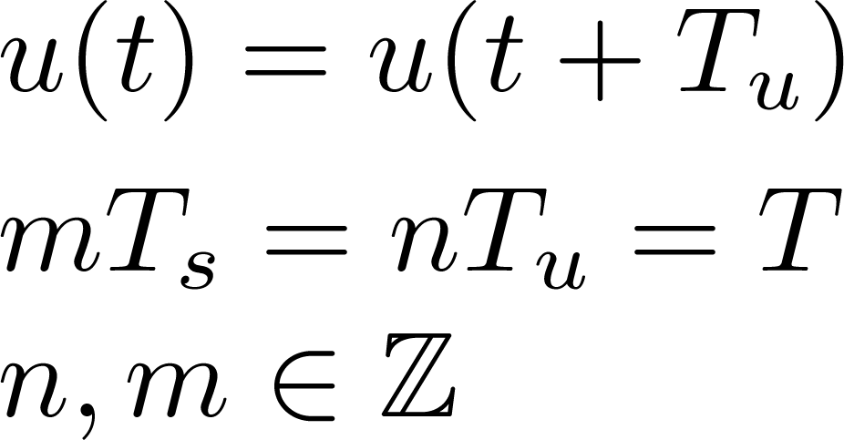
Periodic Small Signal Analysis (PAC)
After having located the periodic steady state solution (a stable limit cycle) we want to use the linearization of the system along such a solution to estimate the effects of small additive periodic perturbations.

Slide 44
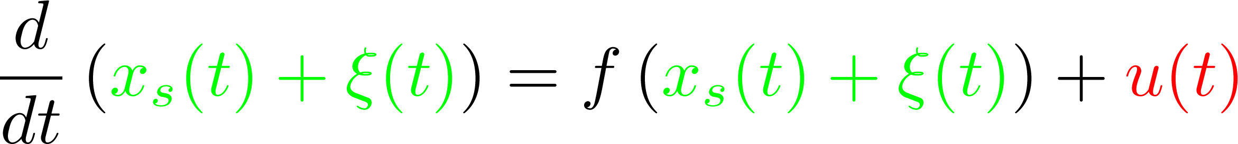
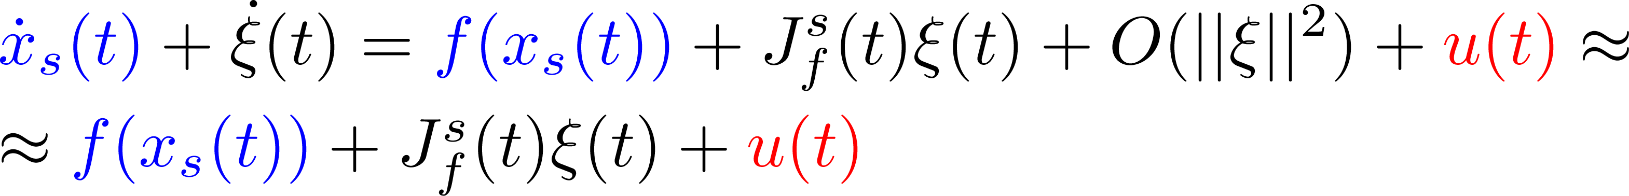
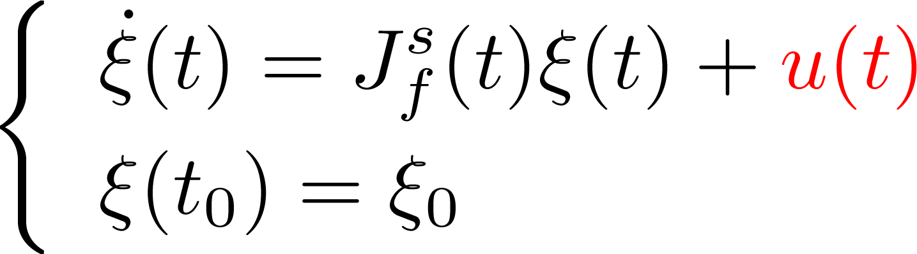
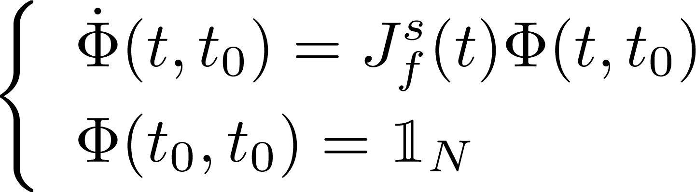
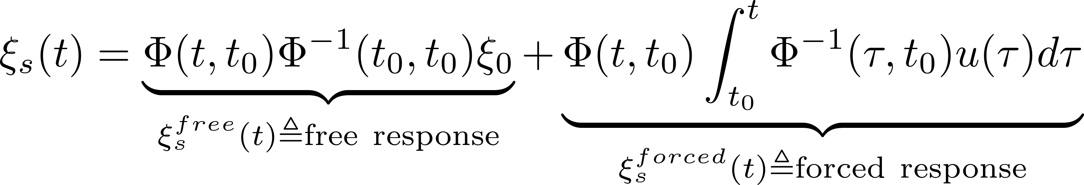
Periodic Small Signal Analysis (PAC)

Slide 45
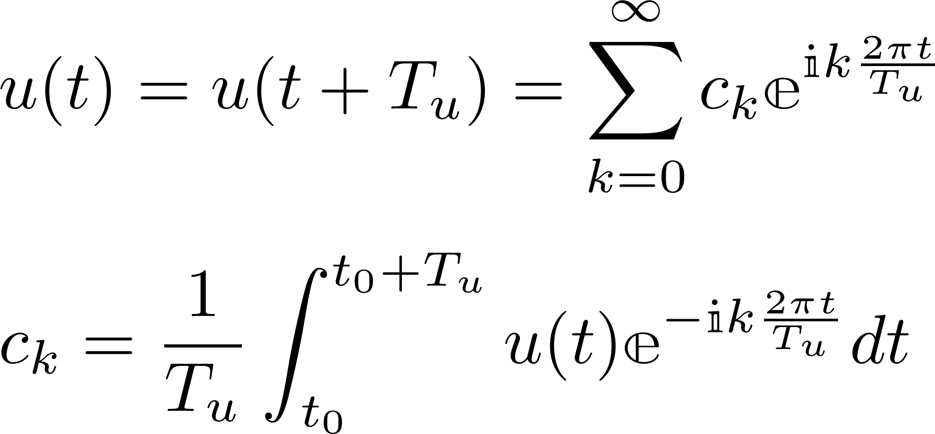
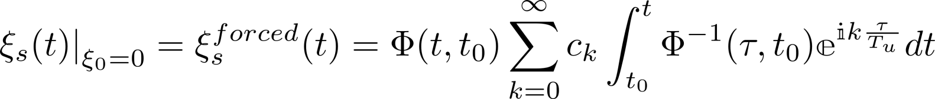
Periodic Small Signal Analysis (PAC)

Slide 46

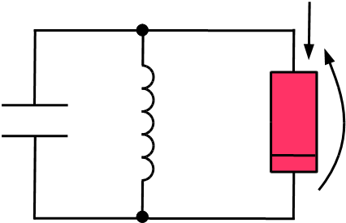






Periodic Small Signal Analysis (PAC)
Van der Pol Oscillator
Periodic Steady State
(T= 6.2871s)

Slide 47






Periodic Small Signal Analysis (PAC)
Small signal output
Large signal

Slide 48





Periodic Small Signal Analysis (PAC)
Large signal spectrum
PAC allows one two estimate the effect of small signal additive periodic signal (perturbation) and evaluate, for instance, its frequency components.
Small signal output spectrum

Slide 49





Two persons (A and B) are very close to each other and they are using their mobile phone: does the activity of A has any effect on B (and viceversa)?
A’s carrier
B’s carrier
B
A
Noise floor
PAC can be used to evaluate if there is or not a folding on the B’s carrier of the spectrum around the A’s carrier (and viceversa).
Noise floor

Slide 50

The hybrid systems modeling framework has been implemented in PAN
http://brambilla.elet.polimi.it/‎
Why PAN has been developed?
The main research area of the developers is “numerical analysis applied to circuit simulation” and “circuit theory”.
PAN has been and is the implementation vehicle for the “new ideas” of the developers.
PAN has allowed the implementation and testing of new algorithms.
PAN is often comparable and sometime better than well known commercial tools such as spectre by Cadence, eldo by Mentor Graphics and hspice by Synopsys. Consider that the ratio between the employers of these companies and the pan developers is about 5000/2.
≈ 700.000 lines of source code
PAN
(half man and half beast)
is an academic spice-like circuit simulator
it is a research product
has been used several times to support industries

Slide 51
In implementing the hybrid systems modeling framework in PAN it has been necessary to …
Extend the Saltation Matrix concept to index-1 DAE since the classical Modified Nodal Analysis that is used to described circuits leads to this type of mathematical model.
Define an algorithm letting the circuit simulator automatically locate switching and impact manifolds without asking the user to specify them.
Define a strategy to handle the effects of “delayed events” (when there is a delay between the manifold hitting and the switching and/or impact event.

Slide 52
Manifold location
EXTRINSIC MANIFOLDS
are known a priory and can be formalised, a good example is given by A2D converters, in fact the thresholds that deﬁne the corresponding digital coding are known a priori, before starting the circuit simulation.
INTRINSIC MANIFOLDS
are not known a priori and must be determined run-time during the circuit simulation (typically can be found in the analog part of the circuit ruled by D2A converters).
A2D
Analog (sub)circuit
Digital behavioral (sub)circuit
D2A

Slide 53











But there are also some ghost manifolds …
Basic comparator
Smooth comparator
In the input signal has a variation larger than
If , OUT is “discontinuos” even if tanh() is Lipschitz continuous and can be inﬁnitely derived
The IEEE ﬂoating point standard (IEEE Std 754-1985) sets relative precision at

Slide 54






Manifold location
(the simplest case of an analog autonomous system with a switching vector field)
intrinsic manifolds are located by resorting to the mapping property of the transition matrix
if f is smooth

Slide 55



Manifold location
We introduced a test function for all the components of the vector field
and monitor
If the inequality does not hold is reduced till a minimum value
If the inequality still does not hold for a switching in the vector field is registered.

Slide 56



Location of the manifold gradient at the switching point
Once the switching time and the state variables at the switching point have been computed:
we assume that the switching manifold is locally modeled with sufficient accuracy by the linear equation
with or
the vector field is explored by linearly varying, one by one, both the state variables and time starting from a point
  laying before the traversal of the manifold
  and sufficiently far (relative accuracy) in order to let the simulator detect the variables involved in the manifold definition

Slide 57












Location of the manifold gradient at the switching point

Slide 58
Concluding Remarks
  Modern circuits need to be modeled in a mixed analog-digital framework
  This does not mean that we are no longer interested in many analyses that are available for analog circuits
  This means that it is really advantageous to be able to extend these analyses to the mixed analog-digital framework
  The formalism of hybrid systems and the saltation matrix operator can be exploited to do it
  It has been done and there is PAN, an academic circuit simulator, able to outperform commercial simulators not simply in performances but in capabilities … you can try … http://brambilla.elet.polimi.it/‎

Slide 59
List of scientific publications
International Journals
Bizzarri, F., Brambilla, A., Storti Gajani, G. “Extension of the variational equation to analog/digital circuits: Numerical and experimental validation”, (2013) International Journal of Circuit Theory and Applications, 41 (7), pp. 743-752
Bizzarri, F., Brambilla, A., Storti Gajani, G. “Steady state computation and noise analysis of analog mixed signal circuits”, (2012) IEEE Transactions on Circuits and Systems I: Regular Papers, 59 (3), pp. 541-554.
Bizzarri, F., Brambilla, A., Storti Gajani, G. “Periodic small signal analysis of a wide class of type-II phase locked loops through an exhaustive variational model”, (2012) IEEE Transactions on Circuits and Systems I: Regular Papers, 59 (10), pp. 2221-2231.
Bizzarri, F., Brambilla, A., Storti Gajani, G. “Phase noise simulation in analog mixed signal circuits: An application to pulse energy oscillators”, (2011) IEEE Transactions on Circuits and Systems II: Express Briefs, 58 (3), pp. 1-5.
Book Section
Integrated Circuits for Analog Signal Processing (2013), Ed. Tlelo-Cuautle, Esteban, Bizzarri, F., Brambilla, A., Gruosso, G., Storti Gajani, G., “Steady State Simulation of Mixed Analog/Digital Circuits”, Springer New York, pp. 243-270.

